Slide 1
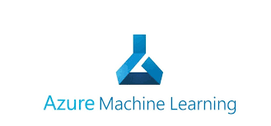
AZURE MACHINE LEARNING SERVICE
Andronic ALEXANDRA
Cîrstea Mădălina
Cîrtsea Natașa

Slide 2
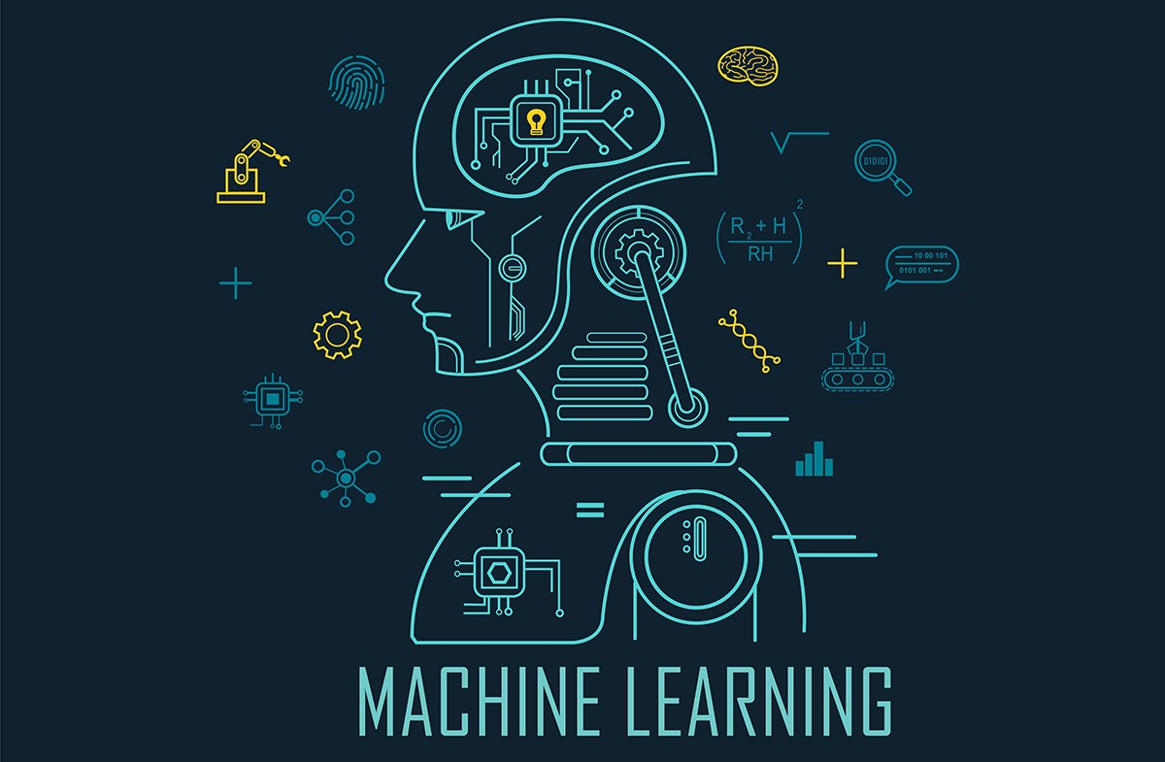
Motivation

Slide 3
FULL MACHINE LEARNING LIFE CYCLE
To operate a machine learning workload you need a bunch of different services:
data storage (for keeping huge amounts of data)
compute power (for running the ml code)
model deployment (to repeat the experiments using consistent setups and different versions) => docker containers
configure a virtual network (configure the compute and data inside the network) to protect the data

Slide 4
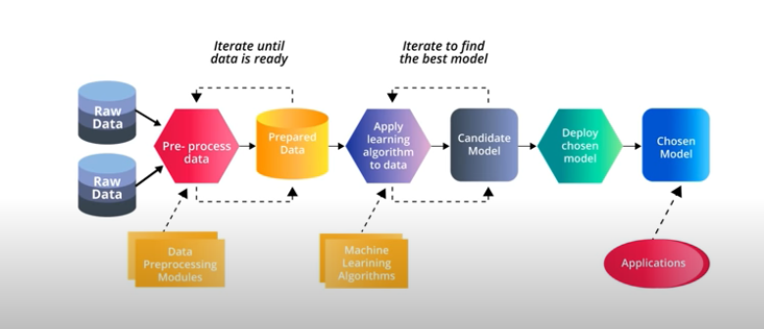
The end-to-end workflow
prepare date -> build, train & test model -> register & manage model
build image -> deploy & monitor service

Slide 5
When Machine Learning and Cloud Computing collaborate with each other, the possibilities are endless. But why ML and Cloud?
Below are some advantages of ML in Cloud Computing:
Traditional Machine Learning libraries do not support well processing of huge datasets. We can store Big Data in the cloud without worrying even a little. Hence, it is easier to perform ML on datasets present in the Cloud.
There are billion people who use the cloud to store their data. As a result, these applications are capable of predicting outcomes that are more accurate because the machine gets a large amount of data to learn from.
With the integration of ML in the cloud, the outcome is an ‘intelligent cloud’. With more advancements in technology, this intelligent cloud will play a crucial role in healthcare, finance, and many other sectors. It will be able to give the best possible outcome for any problem.
Integrating ML in the cloud helps Business Intelligence companies by handling real-time data and analyzing it to make future predictions.

Slide 6
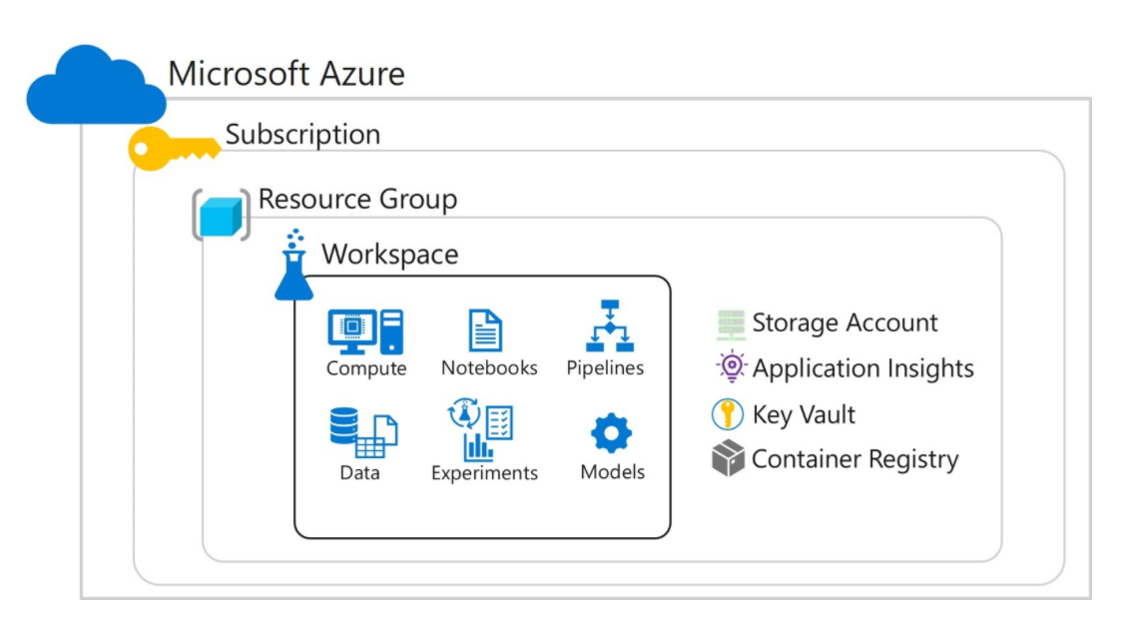
Workspaces as Azure Resources

Slide 7
Workspaces as Azure Resources
Workspaces are Azure resources, and as such they are defined within a resource group in an Azure subscription, along with other related Azure resources that are required to support the workspace.
The Azure resources created alongside a workspace include:
A storage account - used to store files used by the workspace as well as data for experiments and model training.
An Application Insights instance, used to monitor predictive services in the workspace.
An Azure Key Vault instance, used to manage secrets such as authentication keys and credentials used by the workspace.
A container registry, created as-needed to manage containers for deployed models.

Slide 8
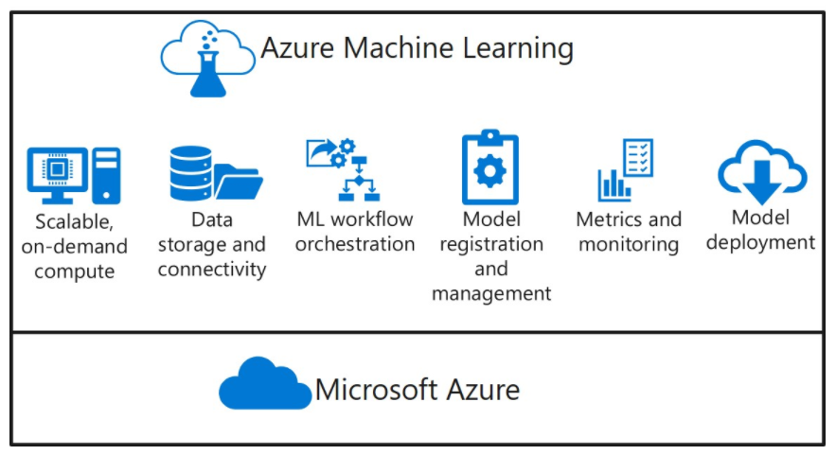
AZURE MACHINE LEARNING is a platform which can operate all of this in the CLOUD

Slide 9
Built on the Microsoft Azure cloud platform, Azure Machine Learning enables you to manage:
Scalable on-demand compute for machine learning workloads.
Data storage and connectivity to ingest data from a wide range sources.
Machine learning workflow orchestration to automate model training, deployment, and management processes.
Model registration and management, so you can track multiple versions of models and the data on which they were trained.
Metrics and monitoring for training experiments, datasets, and published services.
Model deployment for real-time and batch inferencing.

Slide 10
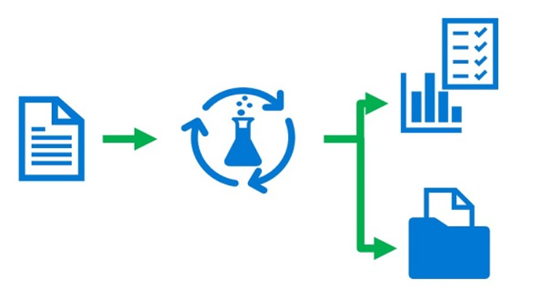
Azure Machine Learning experiments
Like any scientific discipline, data science involves running experiments; typically to explore data or to build and evaluate predictive models. In Azure Machine Learning, an experiment is a named process, usually the running of a script or a pipeline, that can generate metrics and outputs and be tracked in the Azure Machine Learning workspace.
An experiment can be run multiple times, with different data, code, or settings; and Azure Machine Learning tracks each run, enabling you to view run history and compare results for each run.

Slide 11
What is Azure ML?
Azure Machine Learning comes with different tools:
Azure Machine Learning Studio
Azure Machine Learning Service
Azure Machine Learning Service allows us to prep, train, and test our data. We can deploy, manage, and track Machine Learning models starting from our local machines and then shifting to cloud without any hassle. It supports open-source technologies such as TensorFlow, PyTorch, and Scikit-Learn. There is a slight difference between Azure ML Services and Azure ML Studio.

Slide 12
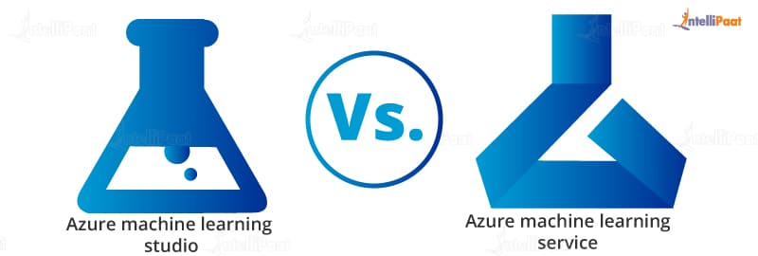
Azure Machine Learning Studio
No coding is required.
It has a drag-and-drop environment.
There are some in-built algorithms and data transformation tools.
We can use it when the predefined algorithms provide a solution.
Azure Machine Learning Service
It is a coding environment.
It is an environment for Python coding (and recently with a new R Support)
We have the full freedom to write our ML algorithms from scratch in any Python/ R environment or directly in the cloud.
This is preferred if the predefined algorithms in ML Studio do not meet our requirements.

Slide 13
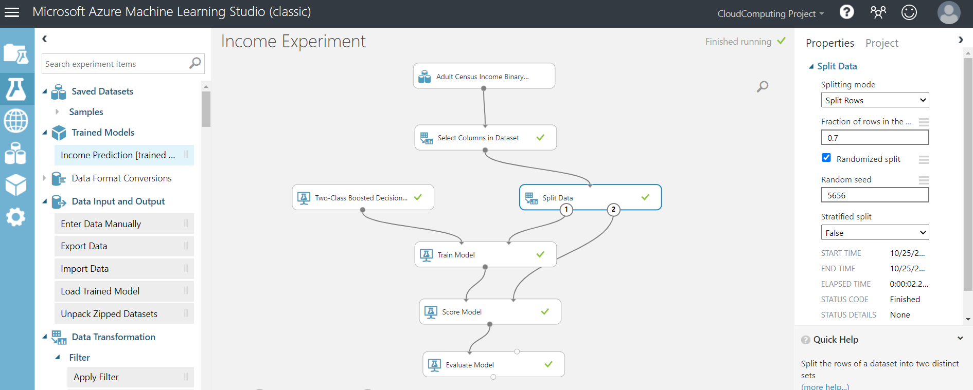
AZURE MACHINE LEARNING STUDIO

Slide 14
The Azure Machine Learning SDK
While graphical interfaces like Azure Machine Learning studio make it easy to create and manage machine learning assets, it is often advantageous to use a code-based approach to managing resources. By writing scripts to create and manage resources, you can:
Run machine learning operations from your preferred development environment.
Automate asset creation and configuration to make it repeatable.
Ensure consistency for resources that must be replicated in multiple environments (for example, development, test, and production)
Incorporate machine learning asset configuration into developer operations (DevOps) workflows, such as continuous integration / continuous deployment (CI/CD) pipelines.

Slide 15
Azure Machine Learning sdk for python
- build better models faster by using the power of the cloud -
Azure Machine Learning provides software development kits (SDKs) for Python and R, which you can use to create, manage, and use assets in an Azure Machine Learning workspace.
Azure Machine Learning SDK for Python is used to build and run machine learning workflows with the Azure Machine Learning service
you can interact with the service in any Python environment - including Jupyter Notebooks, Visual Studio Code, or your favorite Python IDE
train the model either locally (on your local machine) or by using cloud resources, then scale them out to the cloud

Slide 16
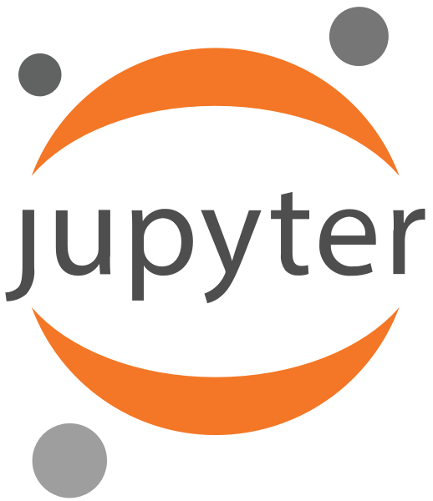
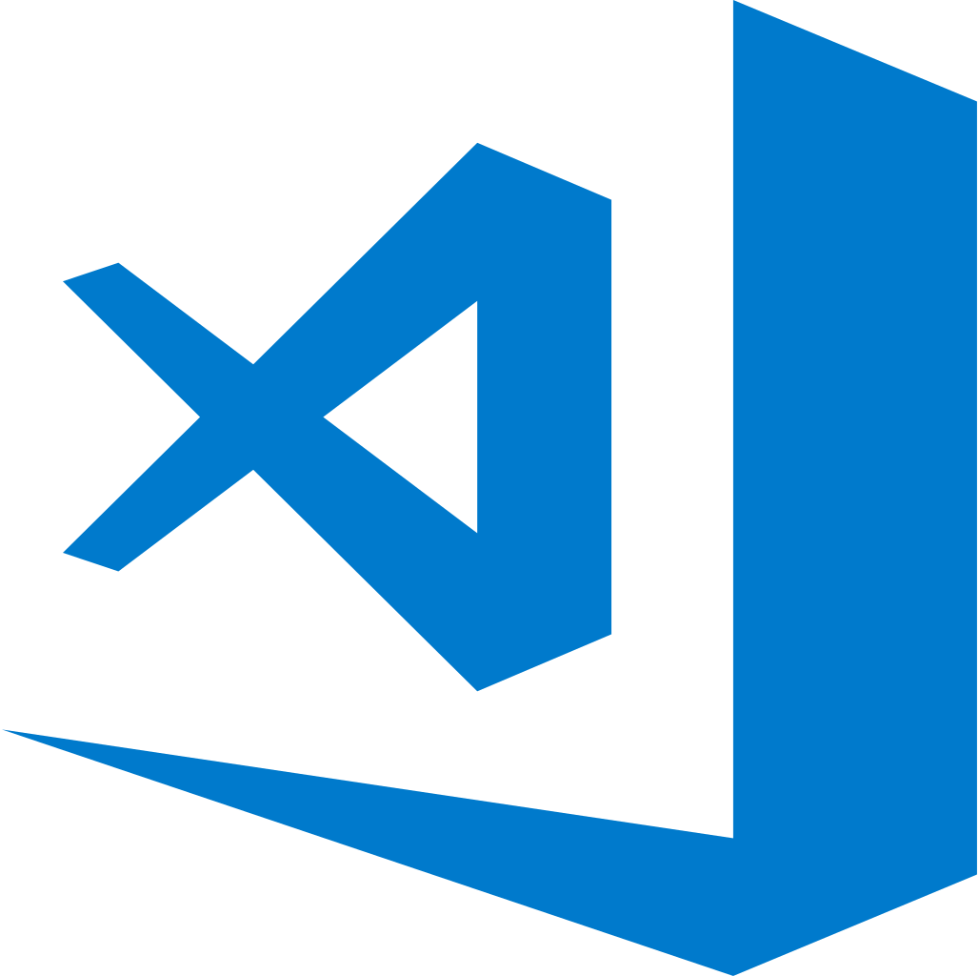
AML SDK allows you the choice of using local or cloud compute resources, while managing and maintaining the complete data science workflow from the cloud.

Slide 17
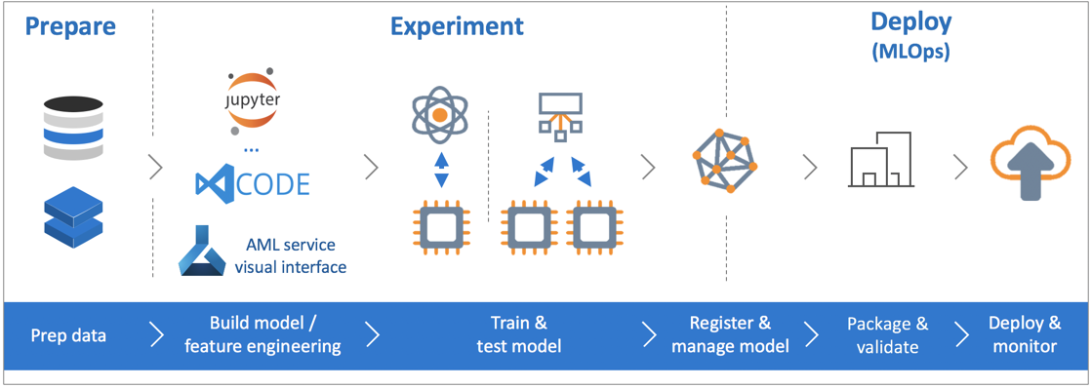
STEPS:
Explore, prepare and manage the lifecycle of your datasets
Build&Train models either locally or by using cloud resources (eg. GPU-accelerated model training)
Deploy web services to convert your trained models into RESTful services that can be consumed in any application.

Slide 18
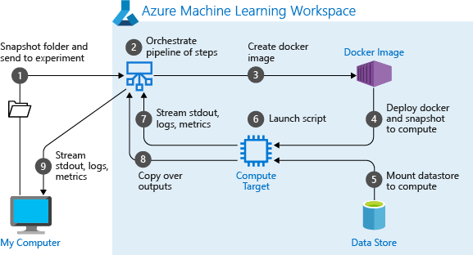
All while we can manage cloud resources for monitoring, logging, and organizing your machine learning experiments.

Slide 19
Azure machine learning sdk
Code based approach using Jupyter Notebook
TASK: Train an image classification model with Azure Machine Learning
we will train a machine learning model on remote compute resources using a Python Jupyter notebook
we will use and understand the training and deployment workflow for Azure Machine Learning service in training a simple logistic regression using the MNIST dataset and scikit-learn

Slide 20
Step 0:
Prerequisites
on the computer running the notebook, install miniconda - a free minimal installer for conda - an open source package management system and environment management system which can quickly install, run and update packages and their dependencies.
conda easily creates, saves, loads and switches between environments on your local computer. It was created for Python programs, but it can package and distribute software for any language)
Then start Anaconda Prompt and run:
→ conda create -n aml_env python=x.x ipykernel (create environment aml_env with python kernel)
→ conda list env (list all environments)
→ conda activate aml_env (activate environment aml_env)
→ pip install azureml-sdk[notebooks]
→ pip install azureml-opendatasets
→ pip install matplotlib, numpy, scikit-learn
→ jupyter notebook (launch jupyter notebook)

Slide 21
Step 1:
Explore, prepare and manage datasets
Explore: MNIST is a popular dataset consisting of 70,000 grayscale images. Each image is a handwritten digit of 28x28 pixels, representing a number from 0 to 9
Goal: create a multi-class classifier to identify the digit a given image represents
we will use Azure Open Datasets to get the raw MNIST data files
Azure Open Datasets are curated public datasets that can be used to add scenario-specific features to ml solutions for more accurate models

Slide 22
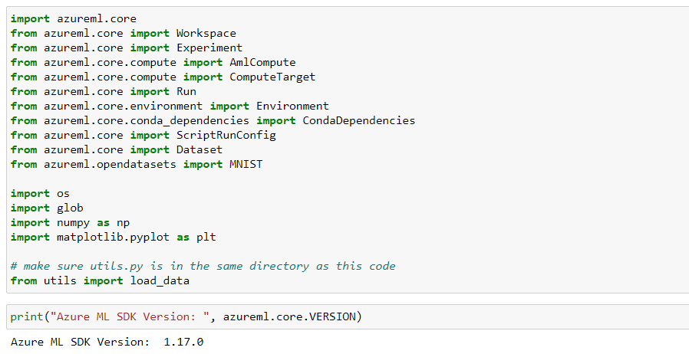
Step 2:
Set up your development environment
Importing packages

Slide 23
Create and connect to a workspace
to enable communication between our local computer and remote resources
from azureml.core import Workspace
ws = Workspace.create()
ws.write_config() - creates a JSON configuration file
containing your subscription, resource-group and workspace name
ws = Workspace.from_config() - load the workspace from the configuration file
ws = Workspace.get() - load an existing workspace without using configuration files
ws.get_details()
Also see: azureml.core.workspace.Workspace from Microsoft AzureML Documentation

Slide 24
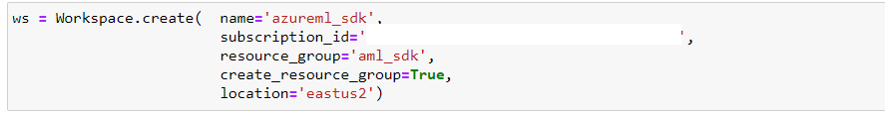
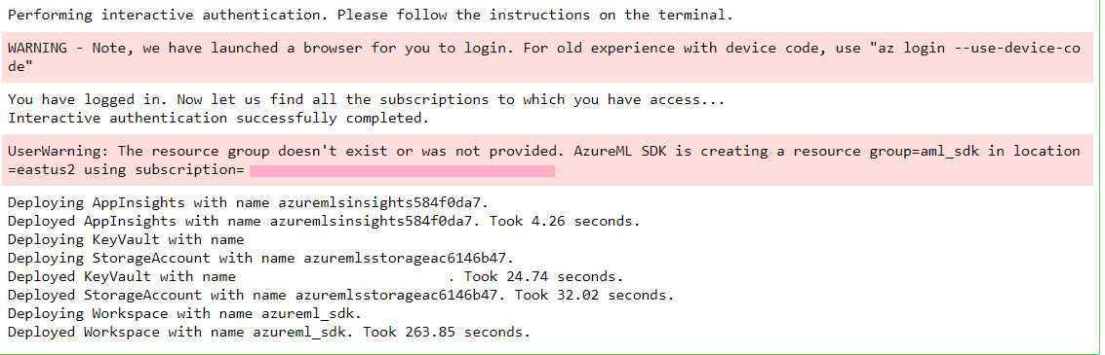
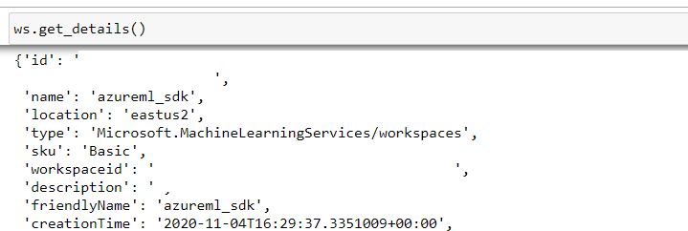


Slide 25
Create an experiment
to track the runs in your workspace (a workspace can have multiple experiments)
in Azure Machine Learning, an experiment is a named process, usually the running of a script or a pipeline, that can generate metrics and outputs and be tracked in the Azure Machine Learning workspace.
Also see: azureml.core.Experiment from Microsoft AzureML Documentation

Slide 26
Create or attach existing compute resource
by using Azure Machine Learning Compute we can train machine learning models on clusters of Azure virtual machines
an Azure Machine Learning Compute (AmlCompute) is a managed-compute infrastructure that allows you to easily create a single or multi-node compute
we will configure a cloud training environment (compute cluster – a VM with GPU support) to which we will submit Python code to run
Also see: azureml.core.compute.AmlComputr and azureml.core.ComputeTarget

Slide 27
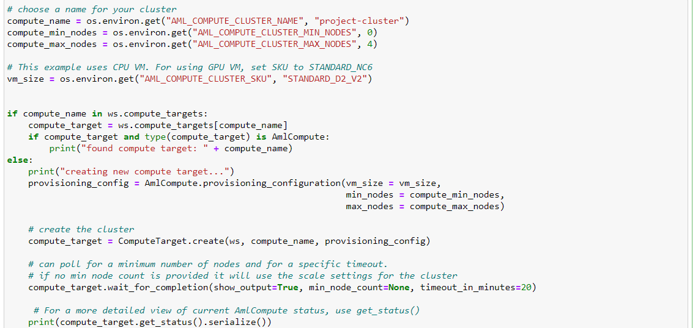
a compute target is a designated compute resource/environment where you run your training script or host your service deployment. This location may be your local machine or a cloud-based compute resource
compute_target = ComputeTarget.create(ws, compute_name)
ws = the workspace object containing the Compute object to retrieve
name = the name of the Compute object to retrieve

Slide 28
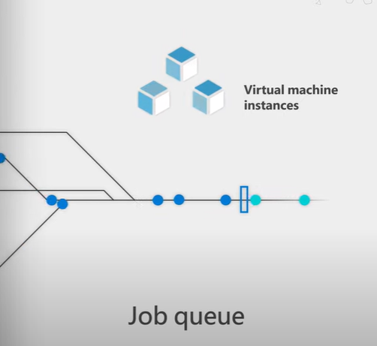
the cluster starts out with 0 VMs in it, then it grows on demand
as the workload increases
we can run as many jobs from the JobQueue in parallel as we allow
as long as we haven’t reached the compute_max_node value
high availability
load balancing
high-performance computing

Slide 29
Step 3:
Train on a remote cluster
Task: define and submit the job to run on the remote training cluster we set up earlier
Create a directory sklearn-mnist
Create a training script train.py (will train a logistic regression model on MNIST dataset)
Create a script run configuration - a ScriptRunConfig object to specify the configuration details:
The directory that contains the scripts
- all the files in this directory are uploaded into the cluster nodes for execution
The compute target (AmlCompute)
The training script name - train.py
An environment that contains the libraries needed to run the script
Arguments required from the training script
Submit the job
.

Slide 30
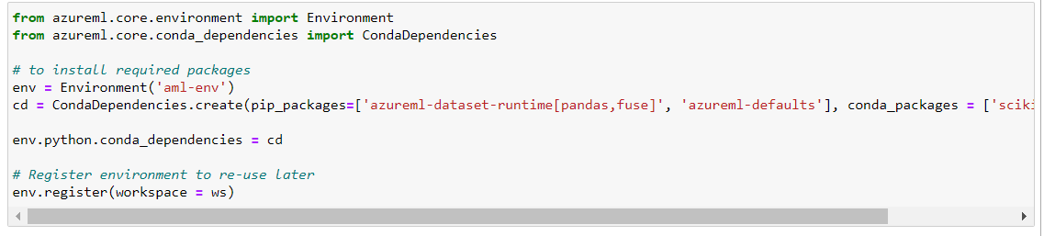
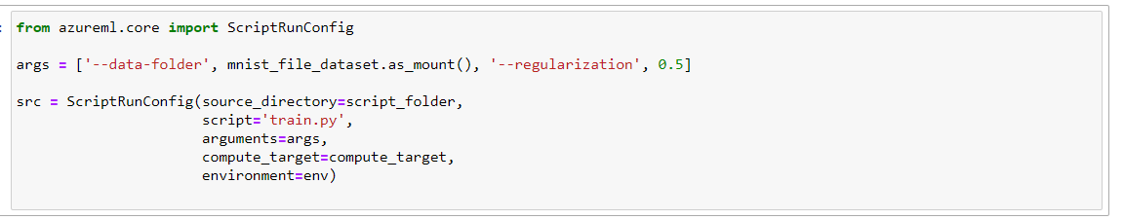
create the environment that contains all the libraries needed to run the script
register it with the Workspace to re-use later
create the ScriptRunConfig by specifying the training script, compute target and environment

Slide 31
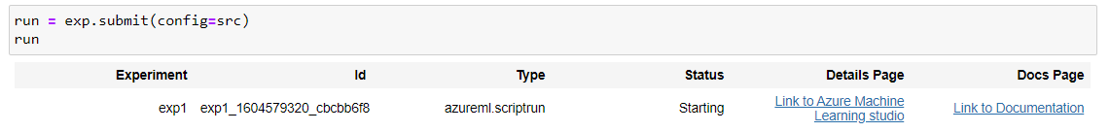
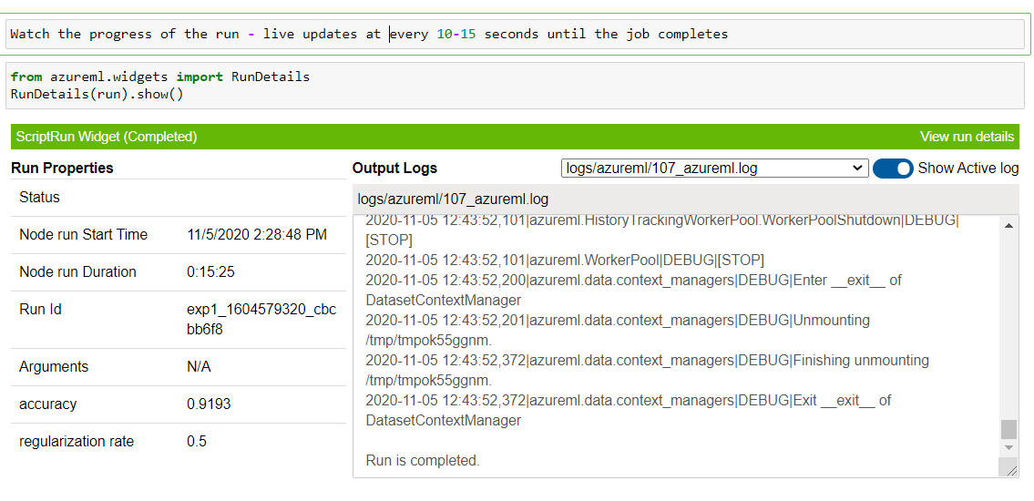
Submit the job to the cluster

Slide 32
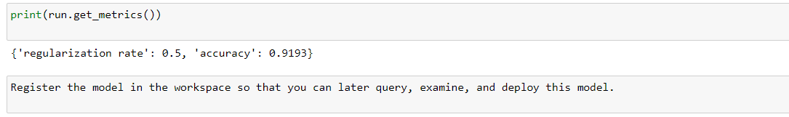
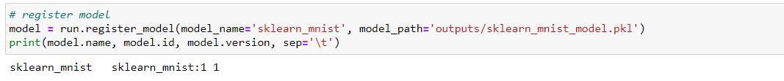
Display results
Register model

Slide 33
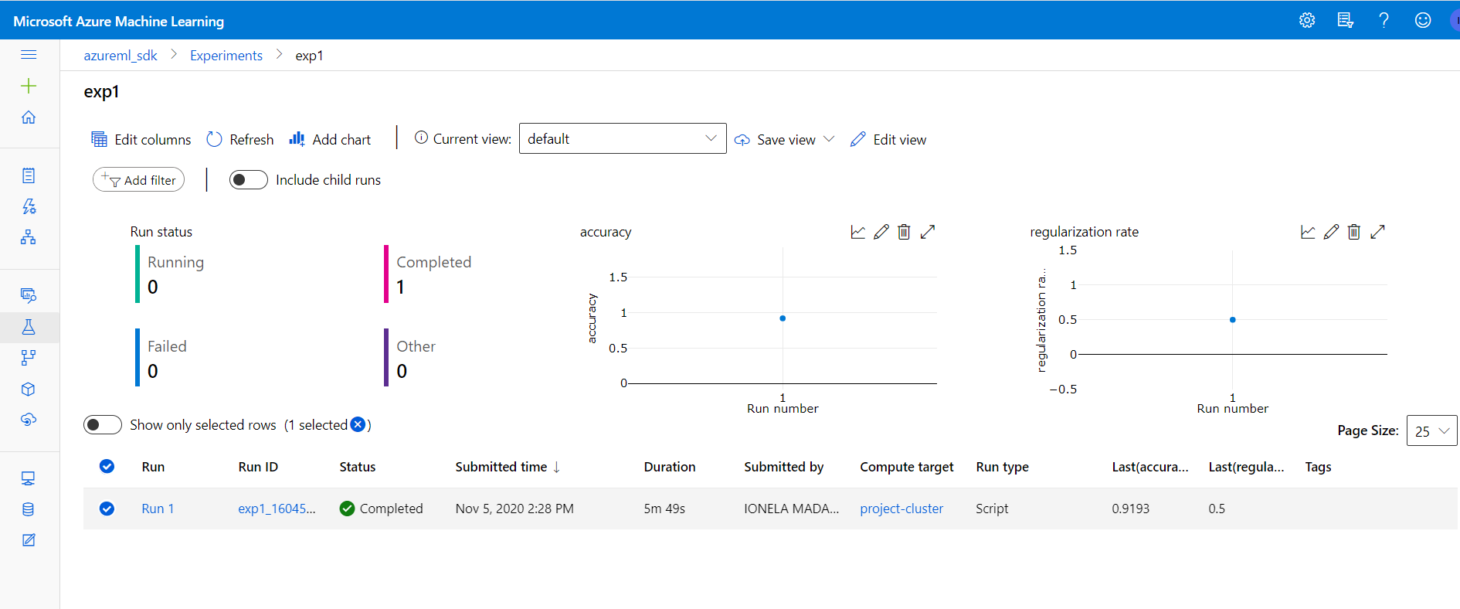

Slide 34
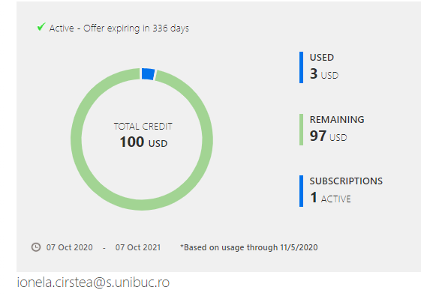
Azure Machine Learning pricing
AML is currently generally available (GA) and customers incur the costs associated with the Azure resources consumed (for example, compute and storage costs).
There are no additional fees associated with Azure Machine Learning
pay-as-you-go pricing: 3 USD for one running
you pay the compute and the storage space while you consume them

Slide 35
Thank you!

